Slide 1
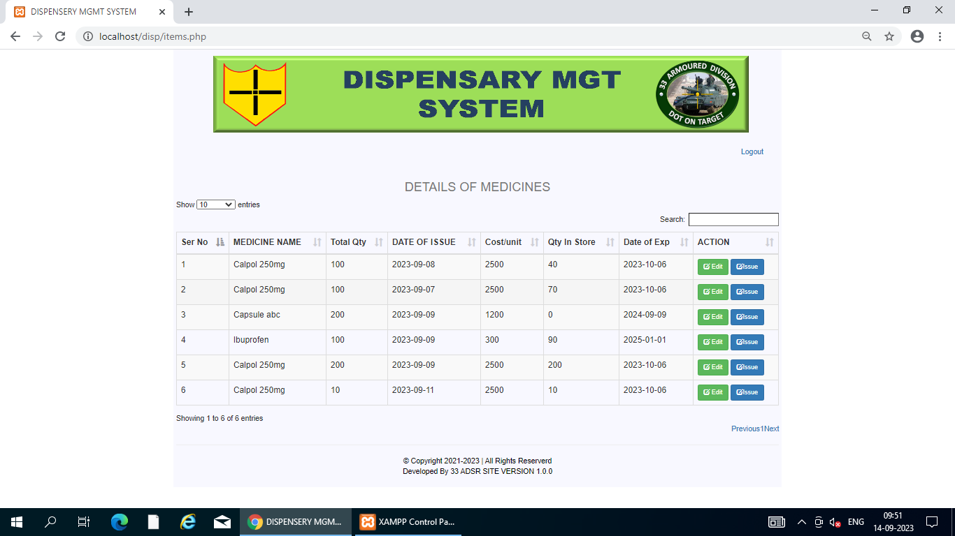
This is User view.
Medicine name may be same but grouped by Date of Issue.
Each Medicine Total qty and qty held is stock is showing.

